Slide 1
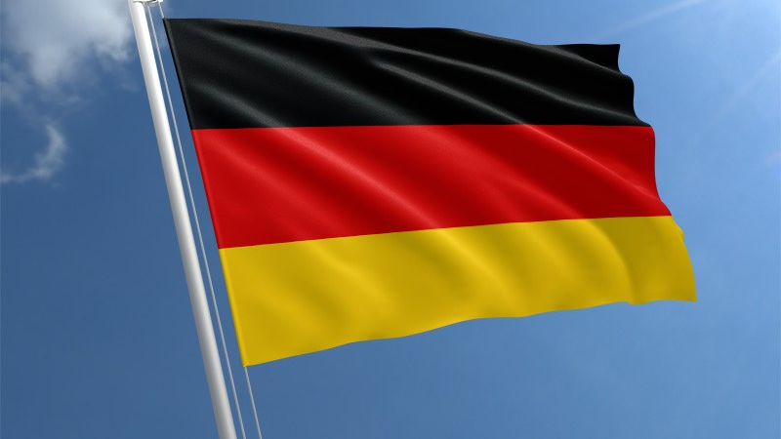
Germany

Slide 2
Outline
Facts about Germany
Sightseeing
Famous people
Traditions
Typical German Food

Slide 3
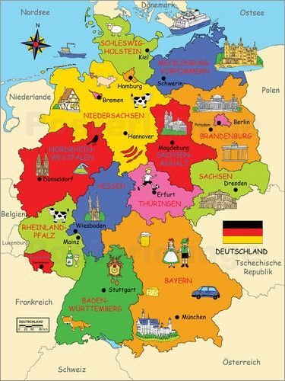
Facts about Germany
State in Central Europe
13.5.1949 founded
83 million inhabitants
16 federal states
Democratic country
Federal capital Berlin

Slide 4
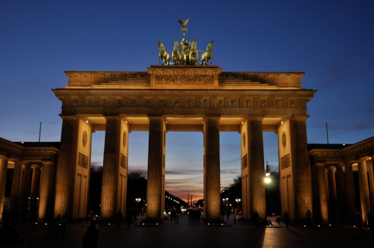
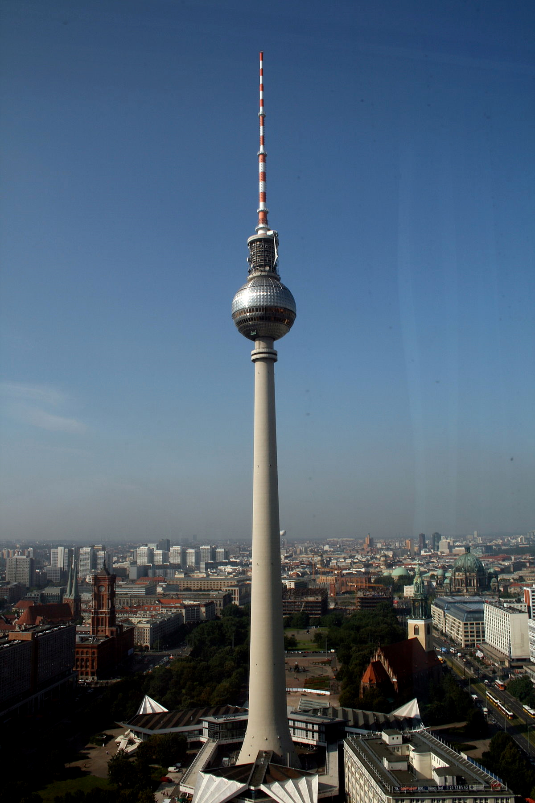
Sightseeing
Brandenburger Gate, Berlin
Television Tower, Berlin

Slide 5
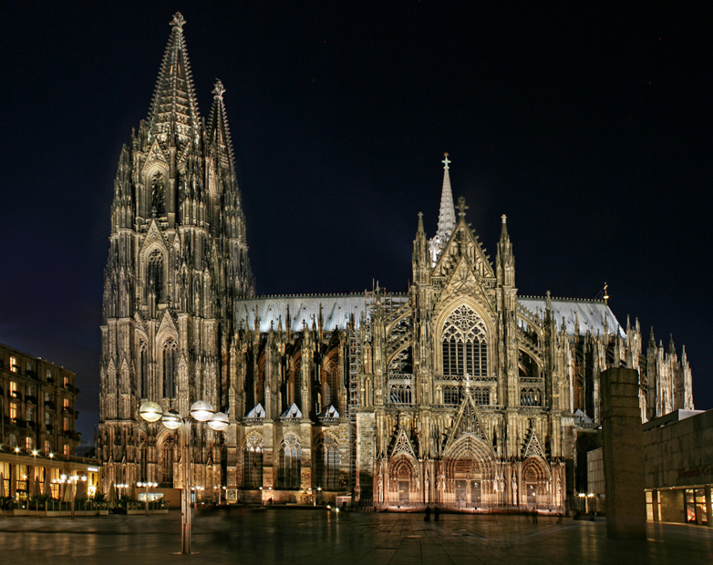
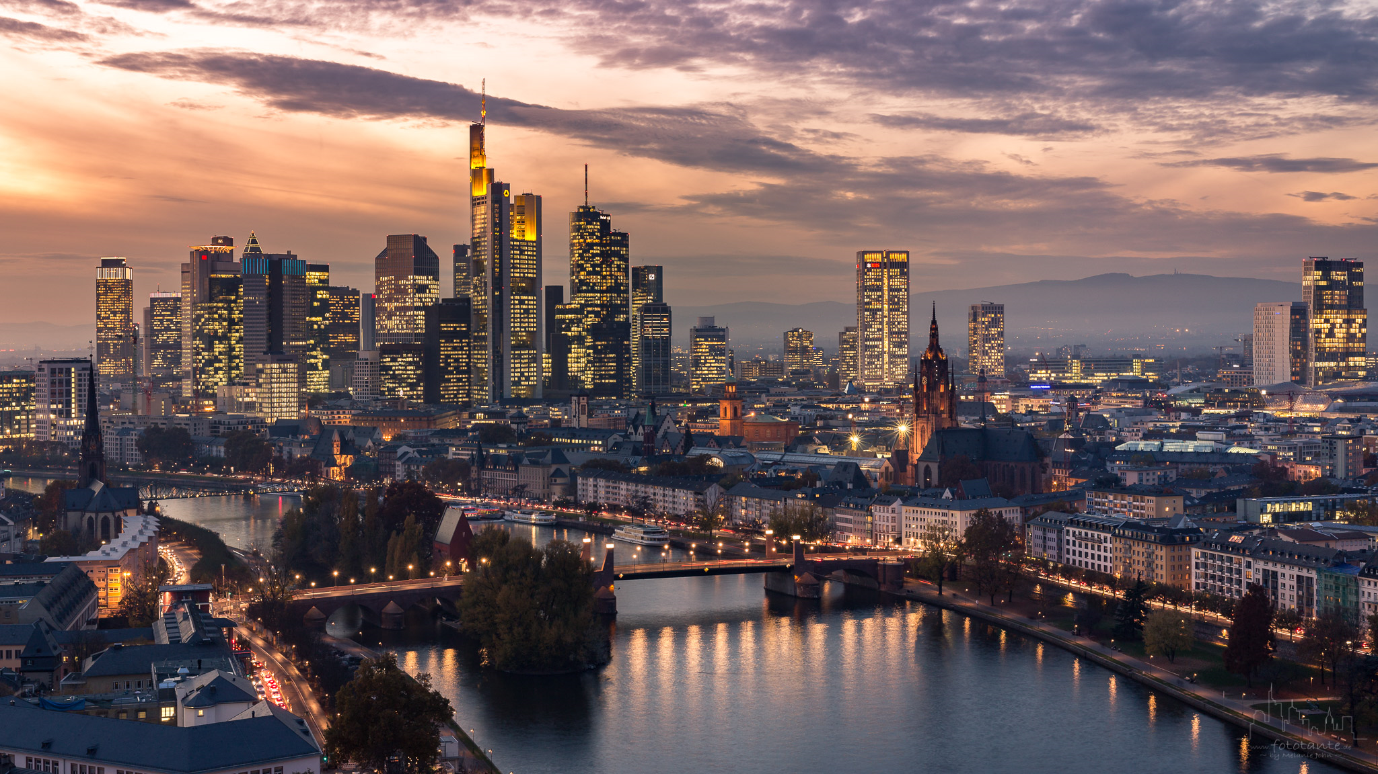
Skyline, Frankfurt am Main
Cologne Cathedral, Cologne

Slide 6
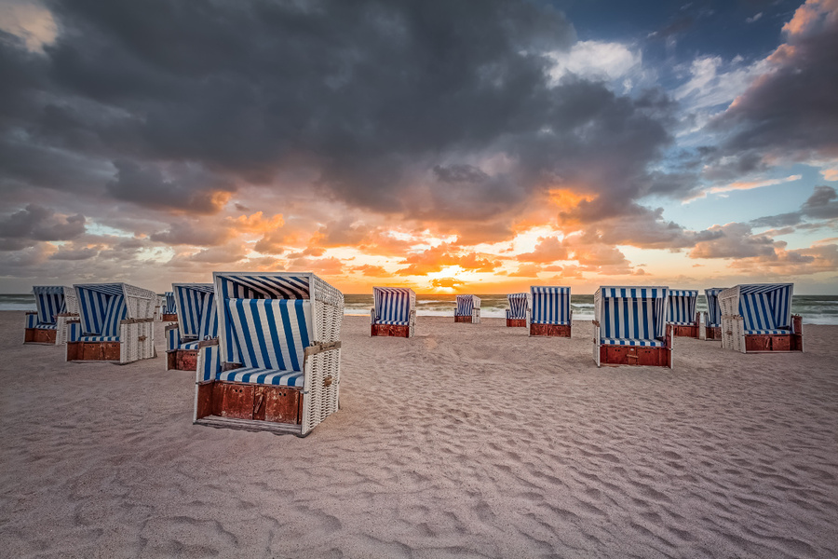
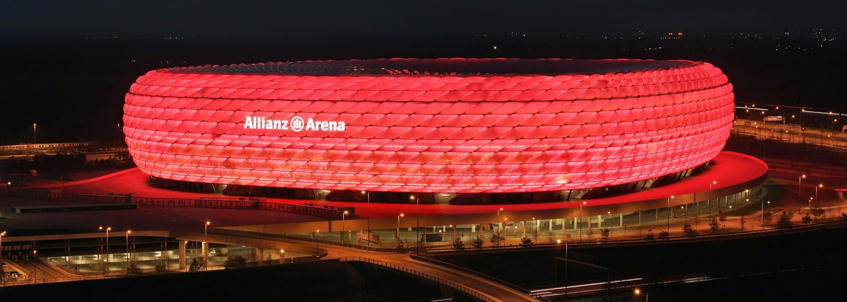
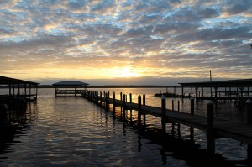
Allianzarena, Munich
North- and Baltic Sea

Slide 7
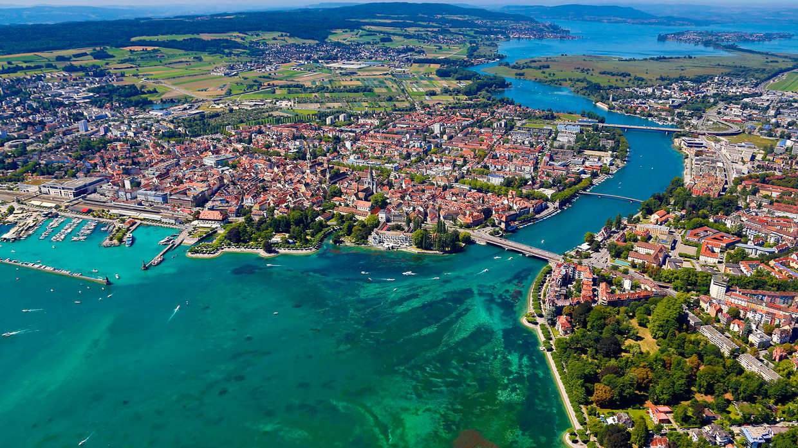
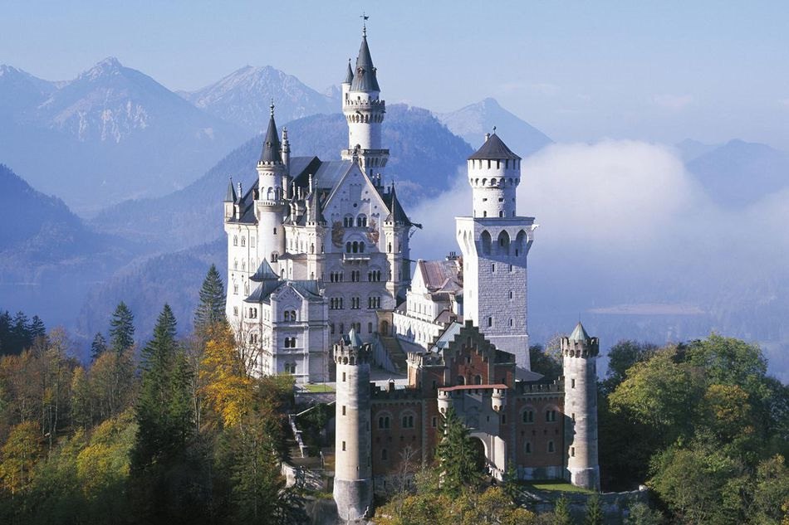
Lake Constance, Baden Württemberg
Neuschwanstein, Schwangau

Slide 8
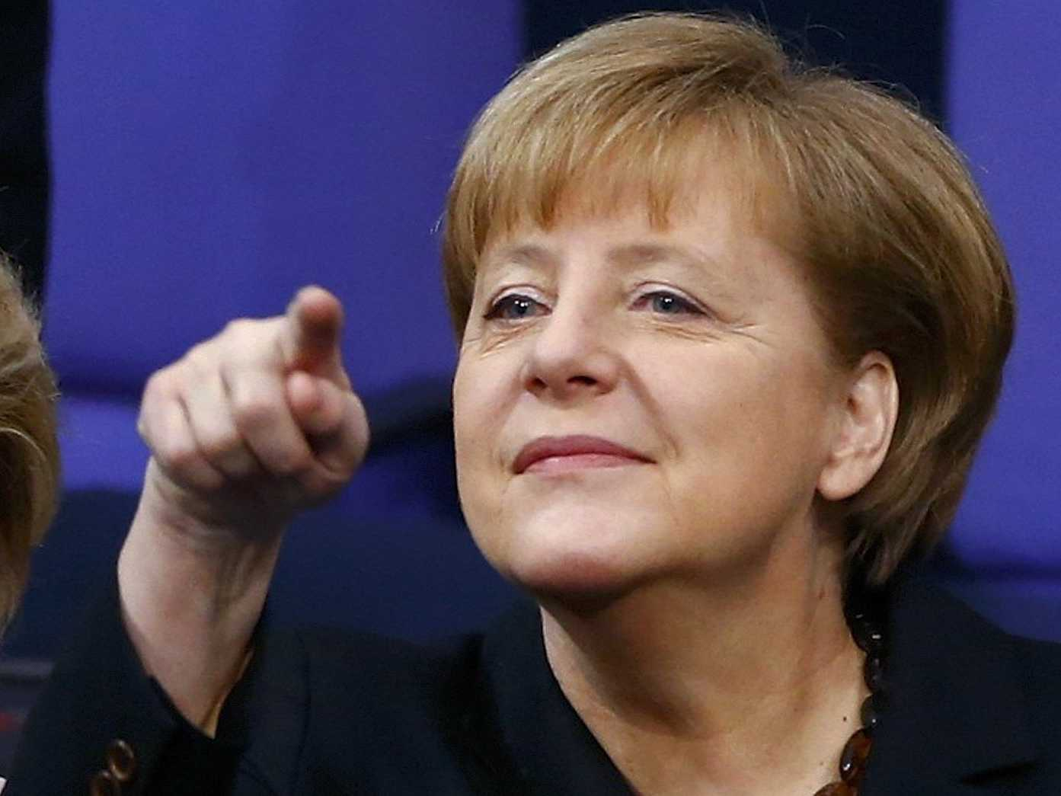
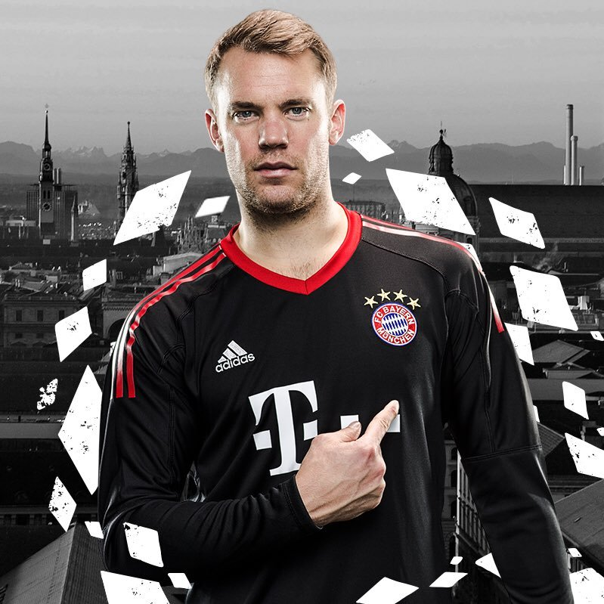
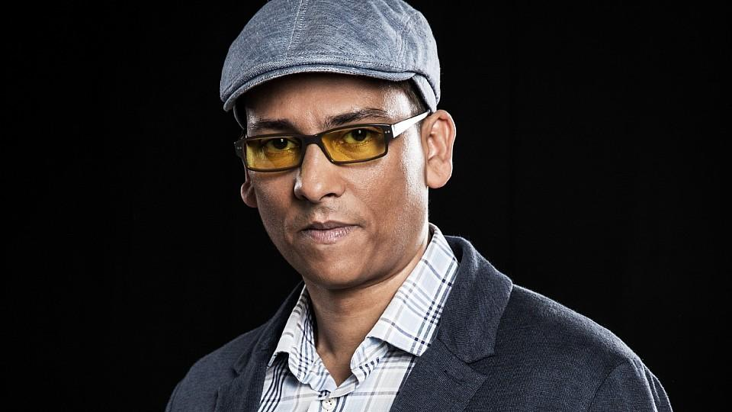
Famous people
Angela Merkel
Manuel Neuer
Xavier Naidoo

Slide 9
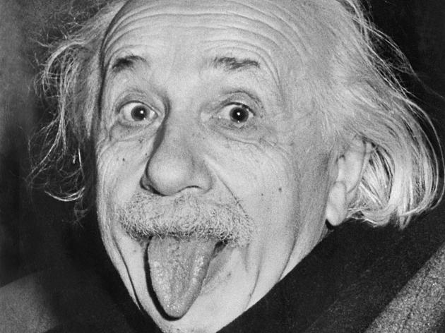
Will never be forgotten
Albert Einstein
Anne Frank

Slide 10
Models
Heidi Klum
Stefanie Giesinger

Slide 11
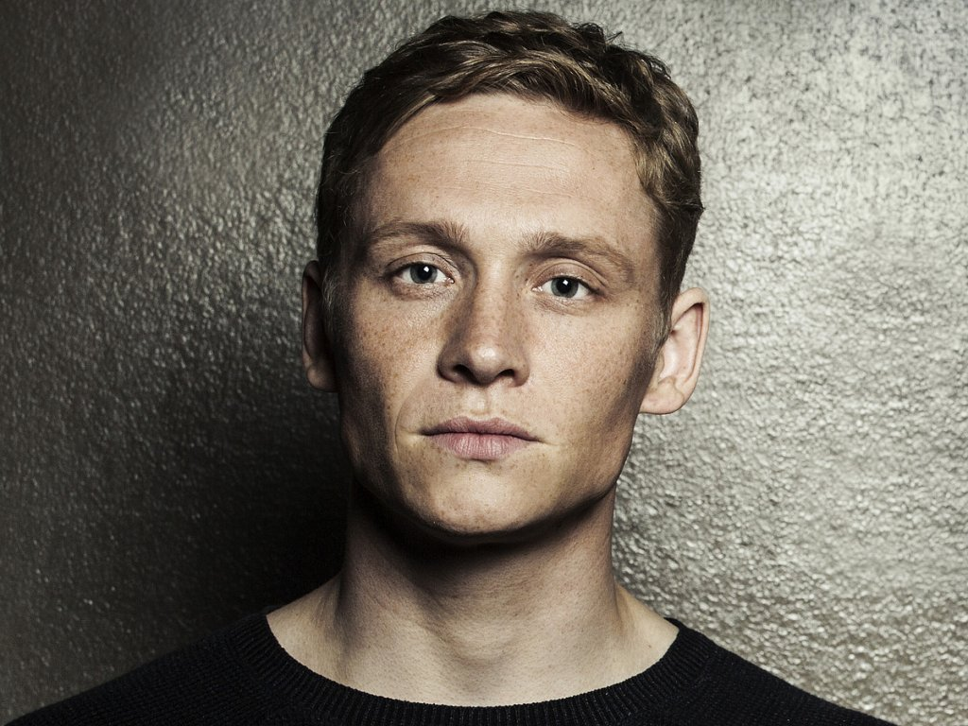
Actors
Til Schweiger
Matthias Schweighöfer

Slide 12
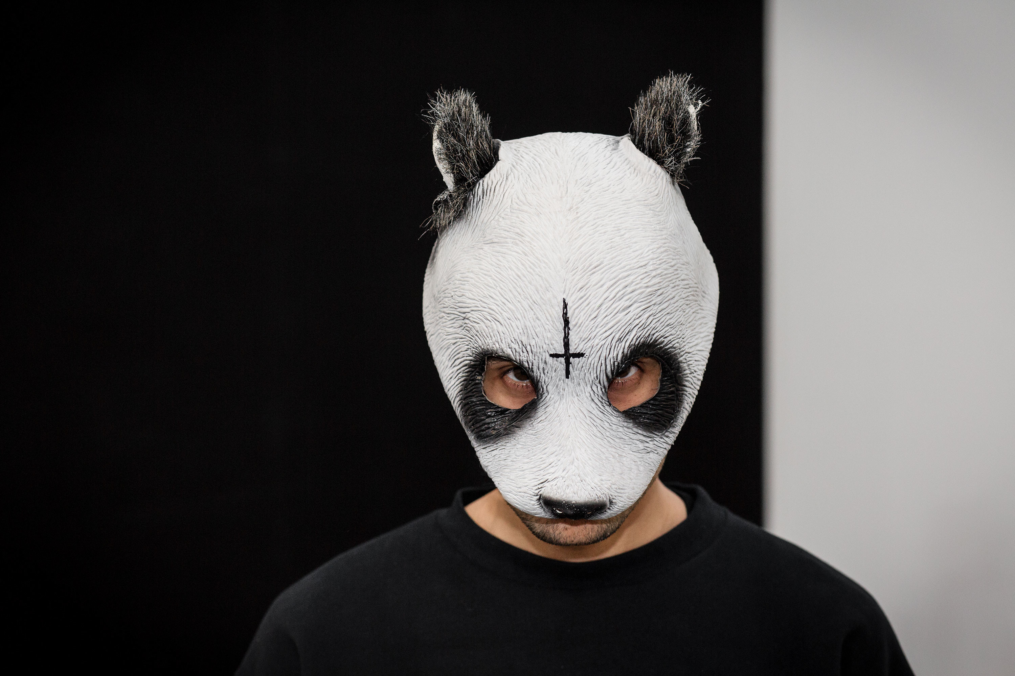
Singers
Sarah Conner
Helene Fischer
Cro

Slide 13
Traditions

Slide 14
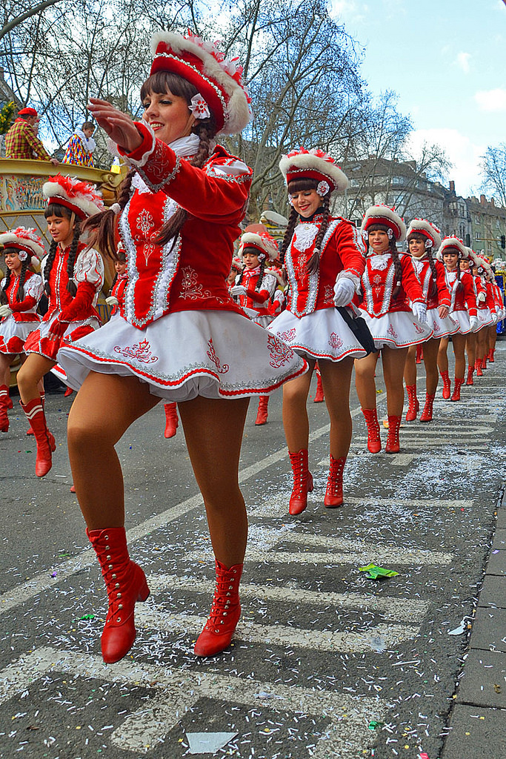
Carnival
Colorful costumes
Street parade
Everybody celebrate

Slide 15
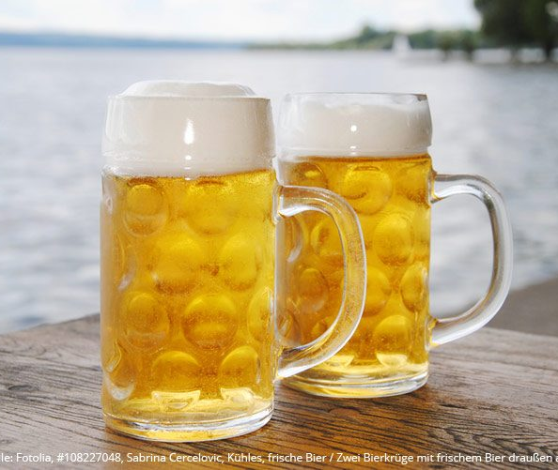
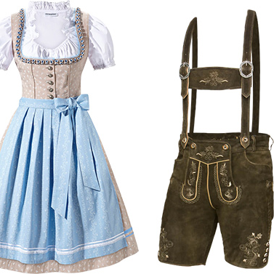
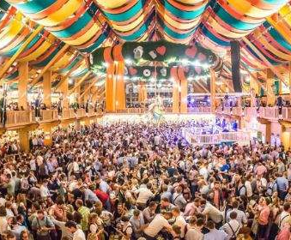
Oktoberfest
Drink as much beer as you can
Dirndl and leather trousers
Gingerbread
Munich Oktoberfest world famous

Slide 16
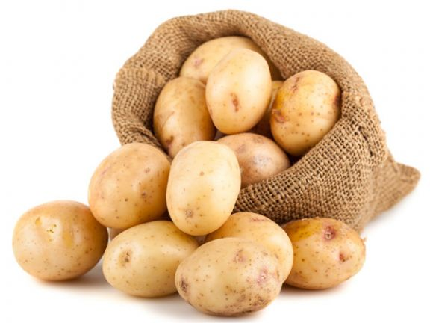
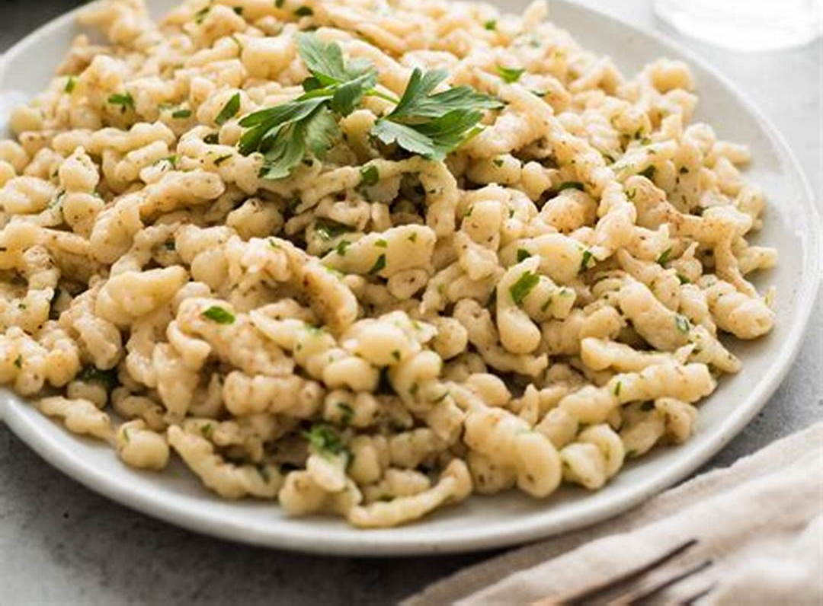
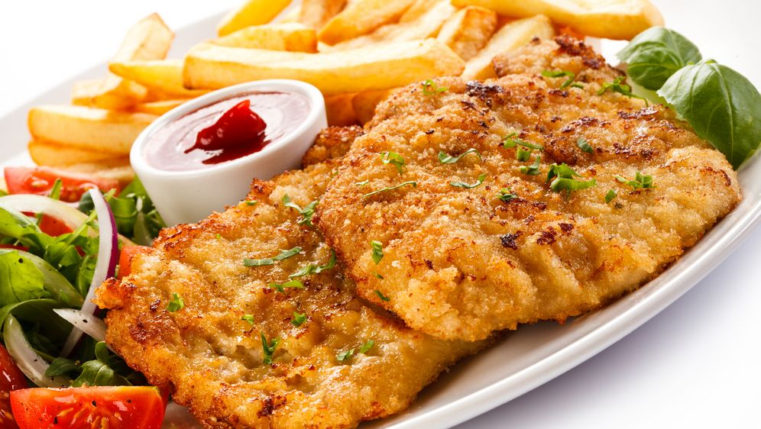
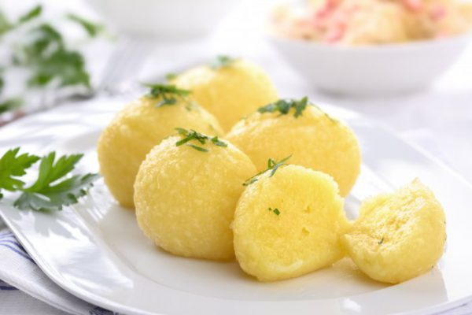
Typical German Food
Potatoes
Spätzle
Bratwurst/Currywurst with Chips
Schnitzel
Knödel

